Slide 1

Unnamed - A NavIC app
rise above the GPS
Geo-positioning powered by ISRO, Made in India

Slide 2
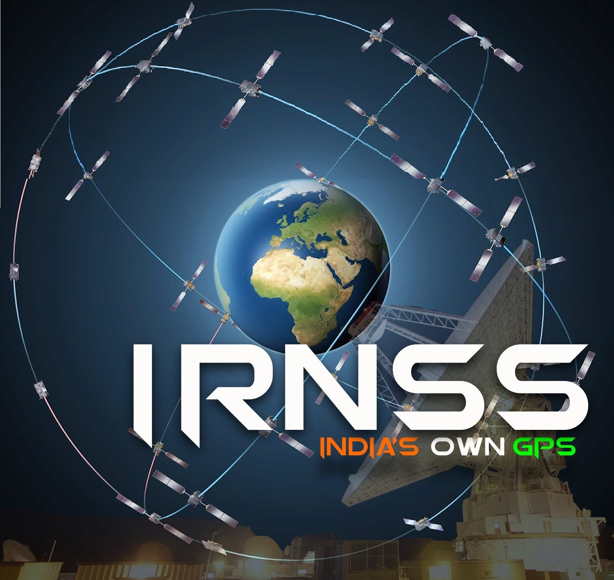
This presentation is about :
NAVigation with Indian Constellation(NavIC)-Receiver Design
Key Features of the application

Slide 3
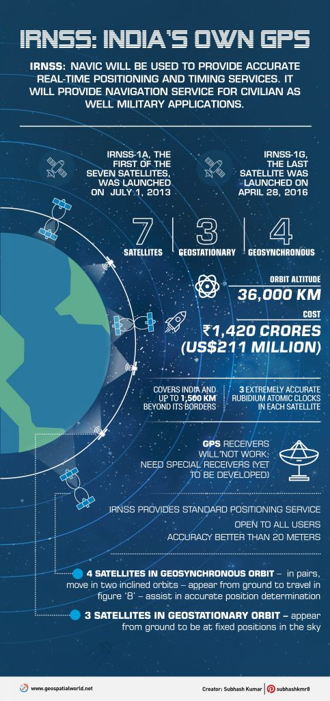
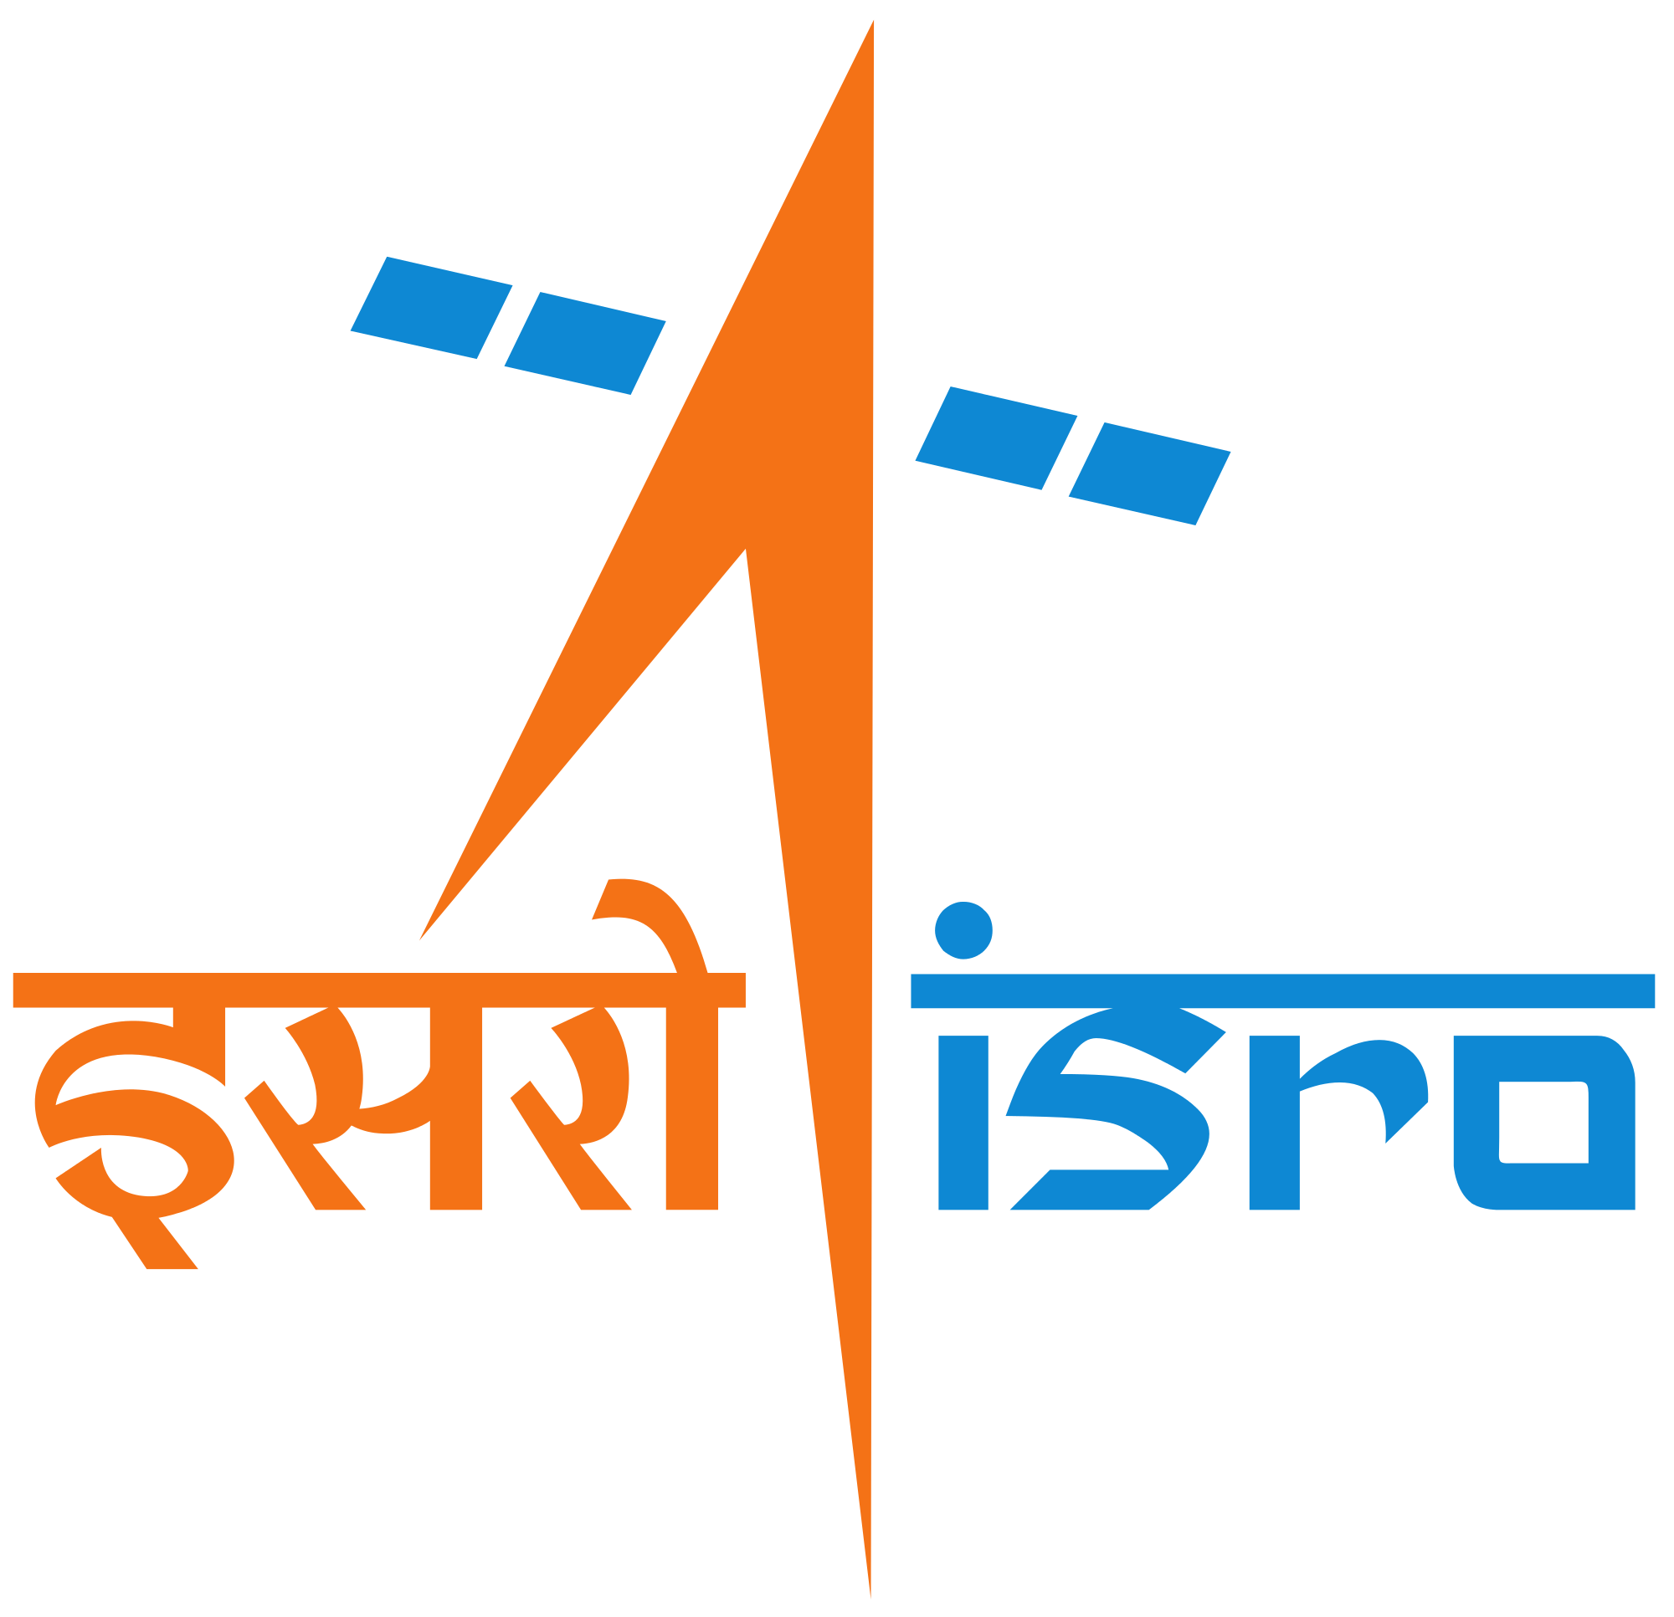
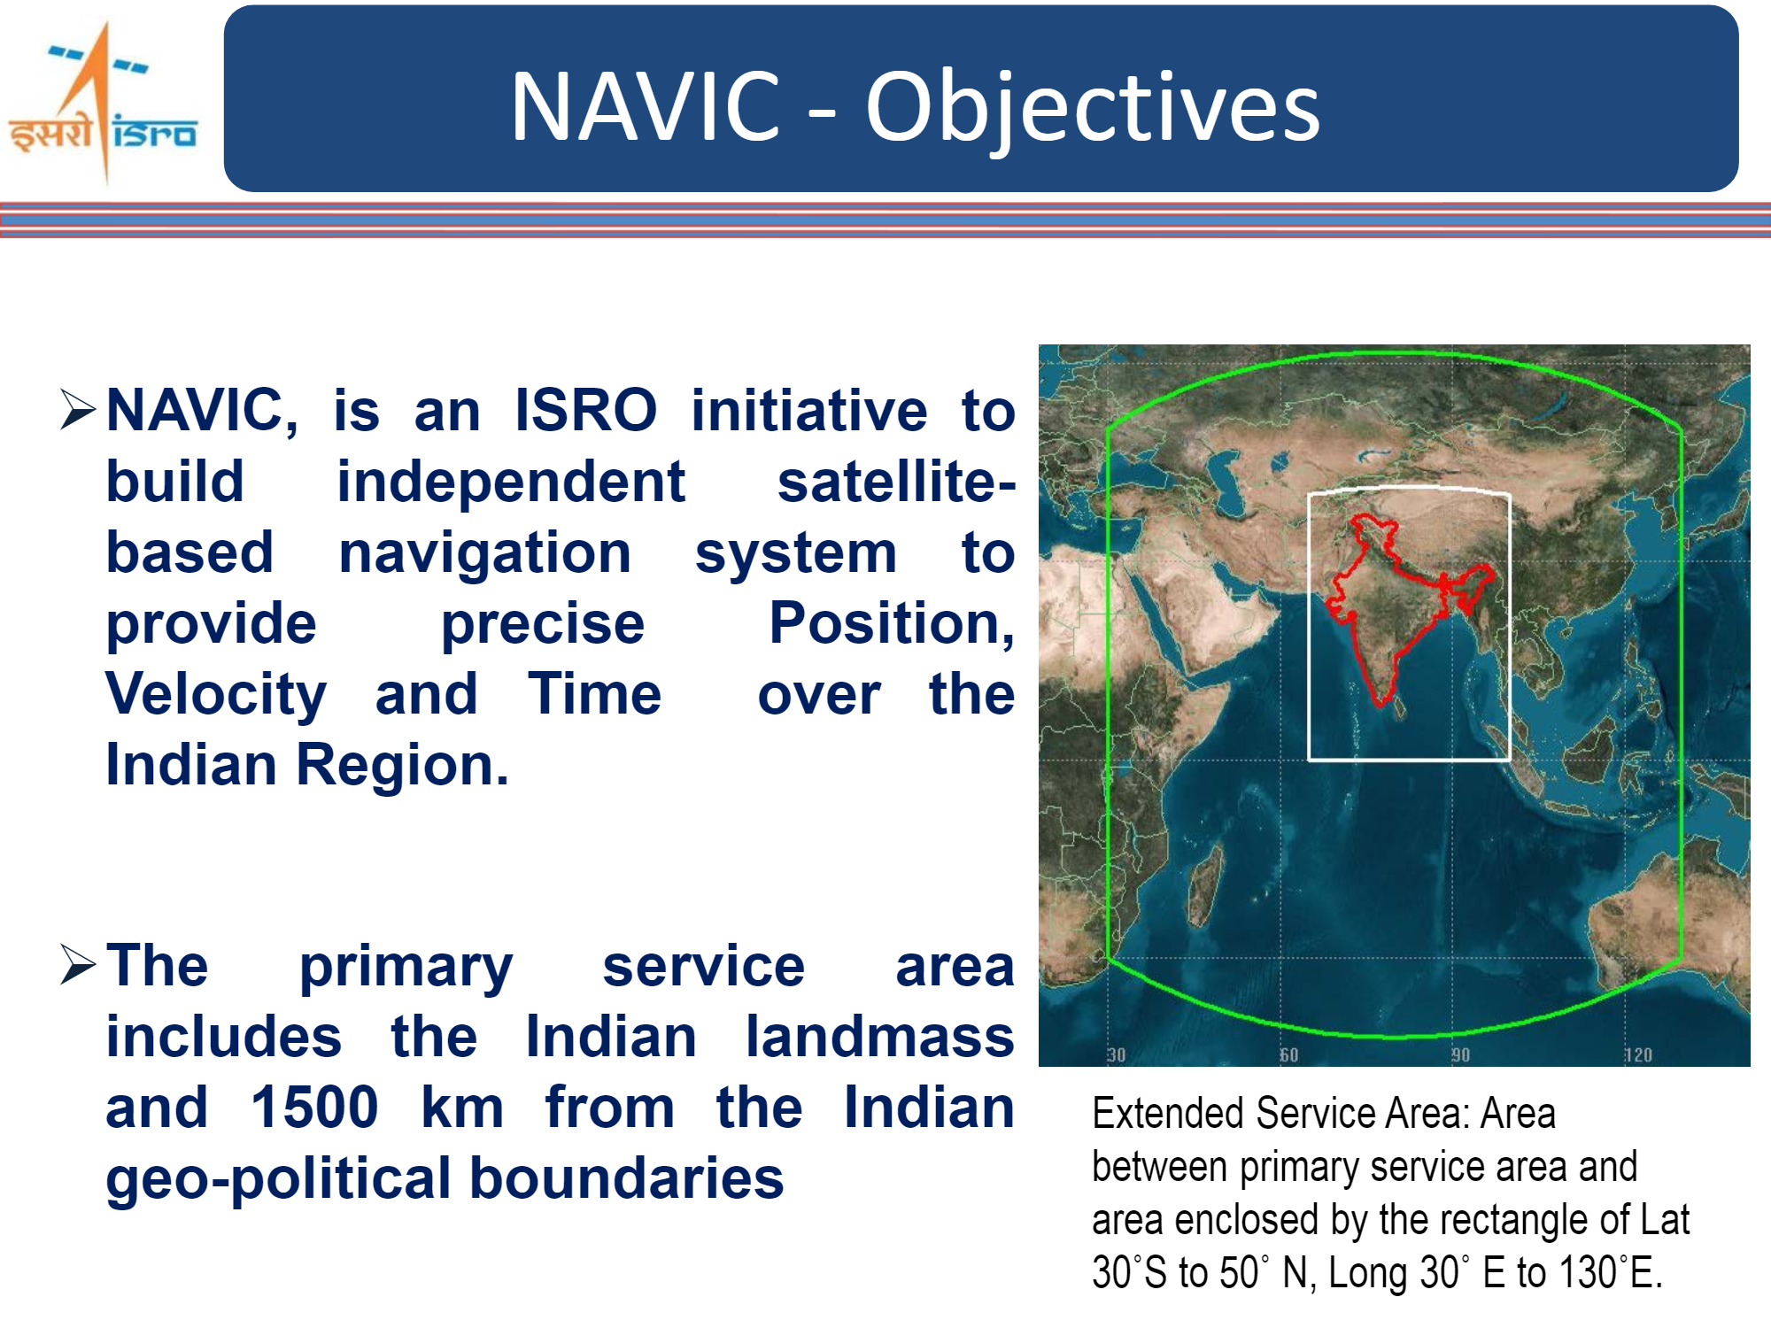
Project objective
The purpose of this project is provide an indigenous alternative to GPS, which can be personalized and tailored for the Indian user.
Besides offering the services of a location-tracker/finder, the app comes with utilities like calamity alert, real-time traffic and weather reporting.
Though many applications provide these features, there are very few options and none of them use NavIC.

Slide 4
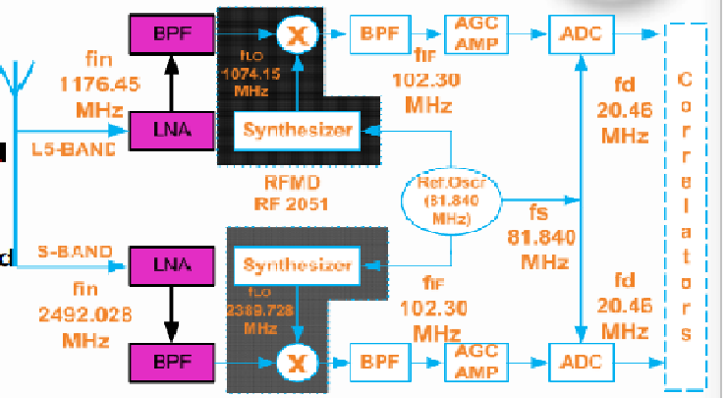
Receiver design
Key Components:
Antenna
LNA
RF Front-end Processor
Correlator and Demodulator
Navigation processor and UI
Courtesy: ISRO

Slide 5
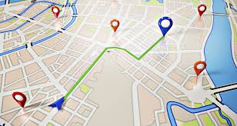

Unnamed
A state-of-the-art application compatible with multiple devices
More accurate compared to GPS, owing to GAGAN and IRNSS.
Features:
Real-time weather reports
Traffic sensing
Calamity alerts

Slide 6
Thank you
The IOT Team:
Saloni Tiwari
Veda Praneetha Edala
Hari Krishnan Nair

